Slide 1
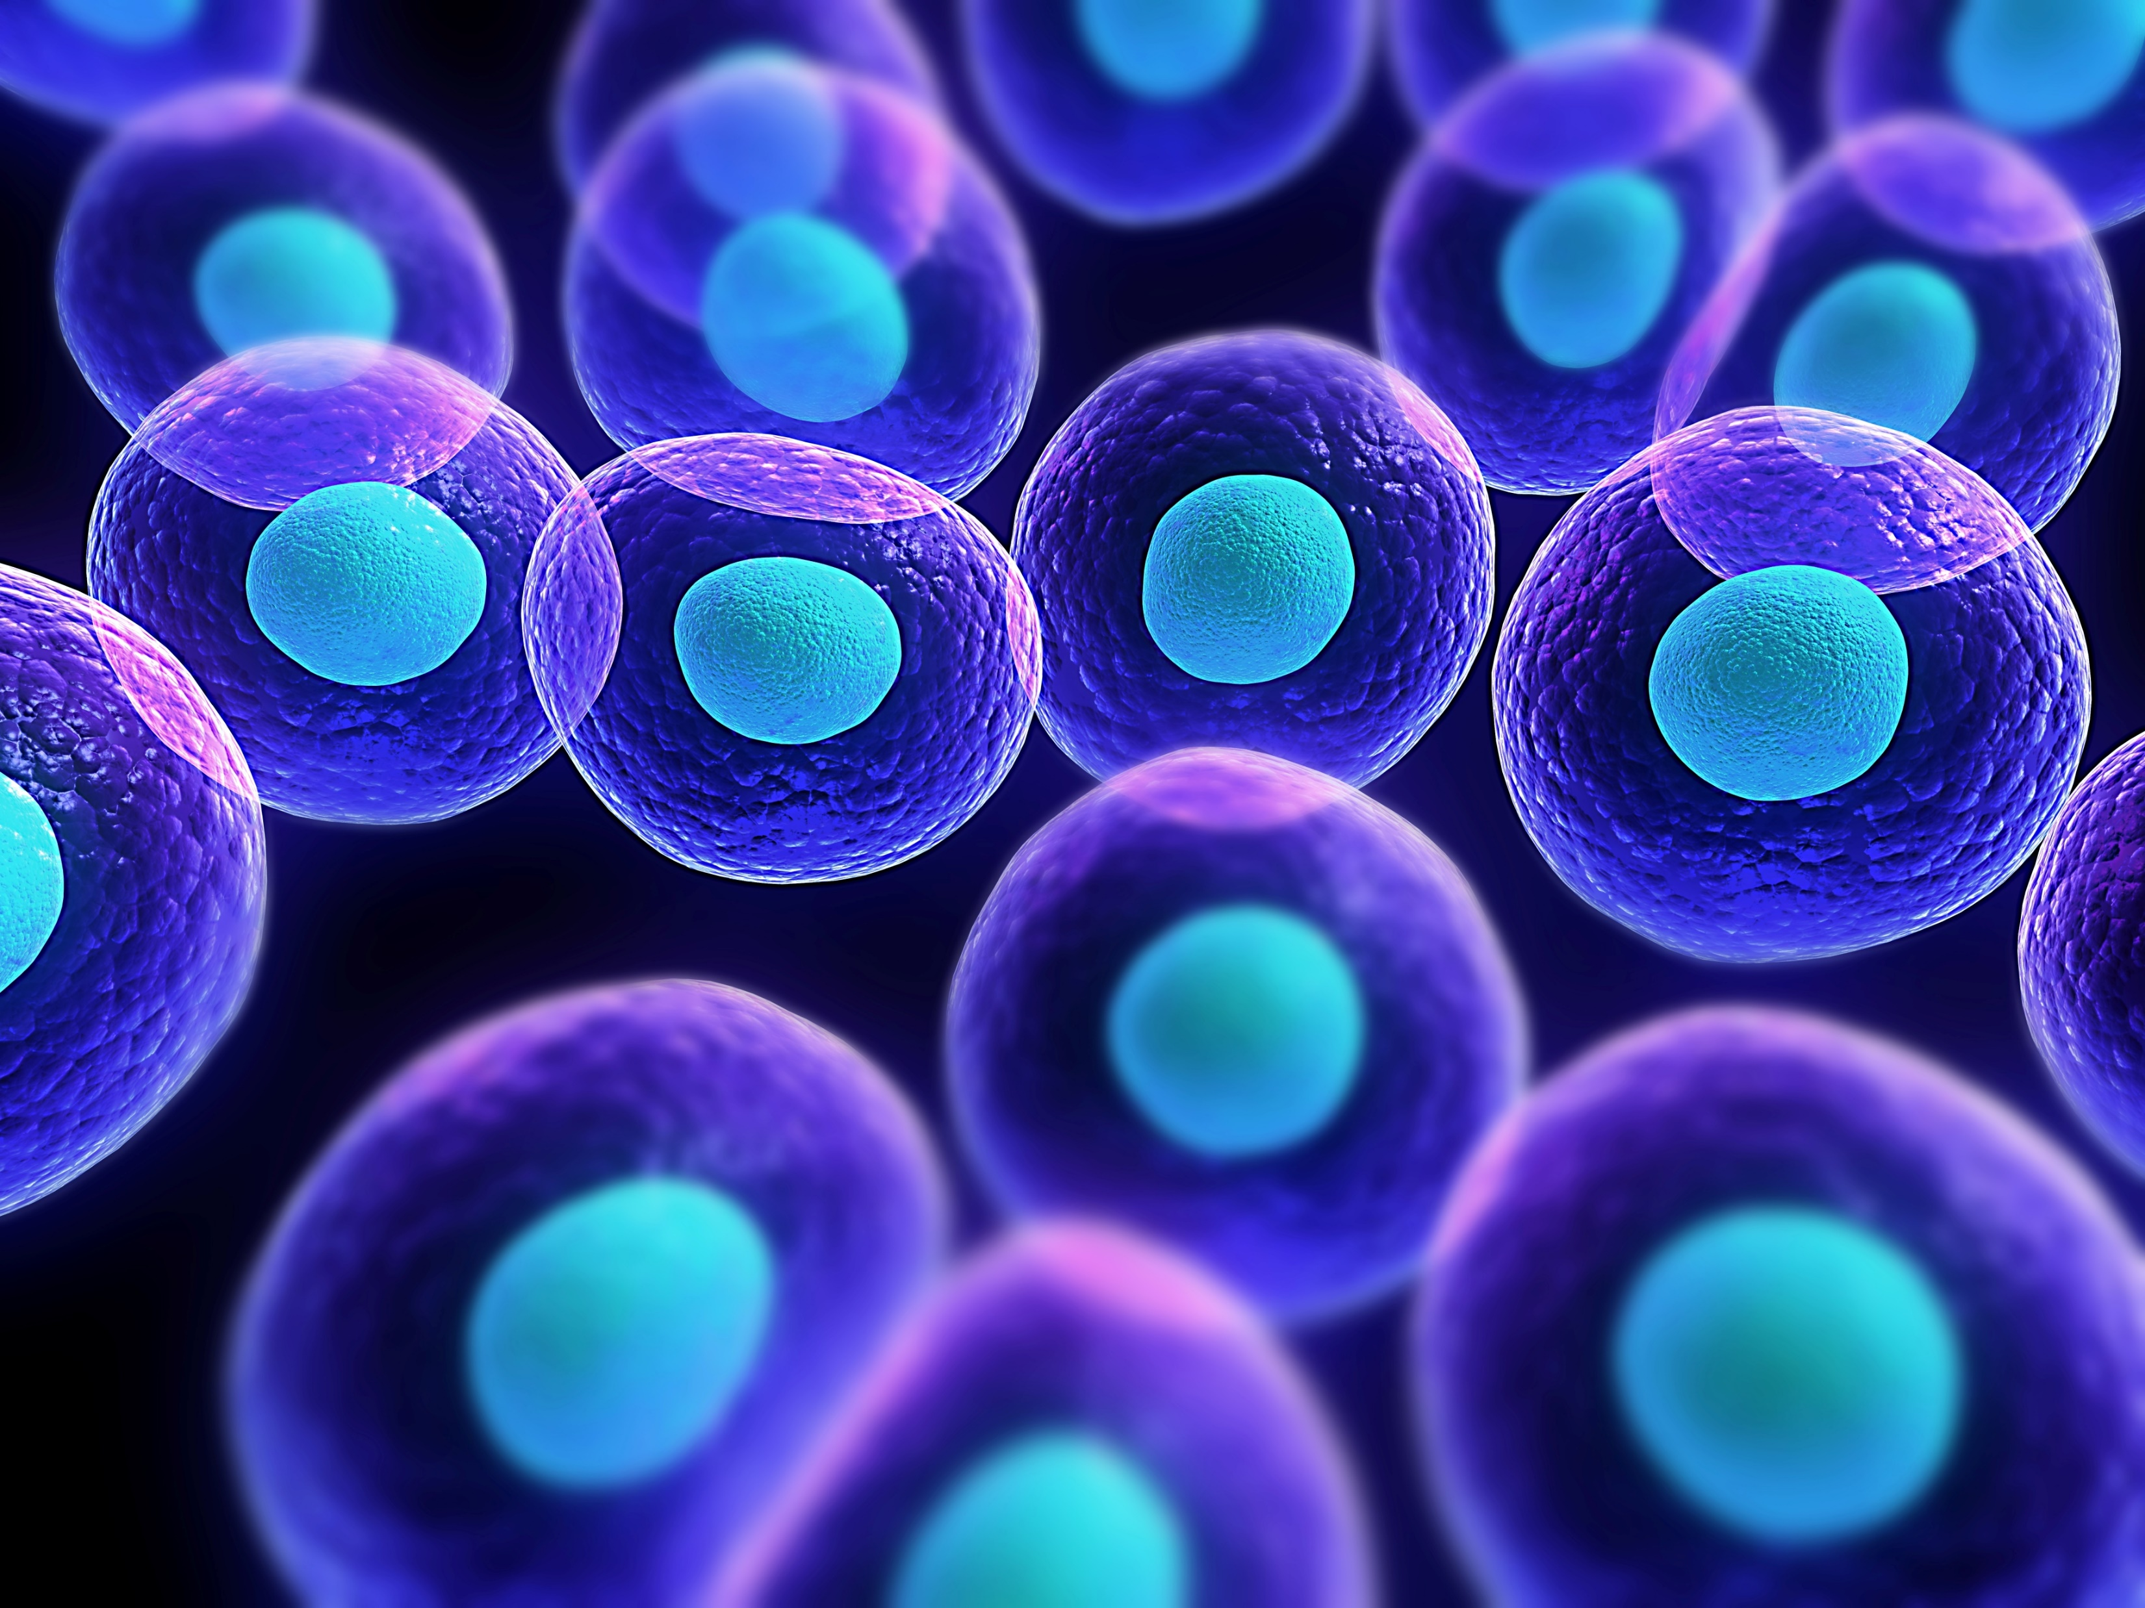
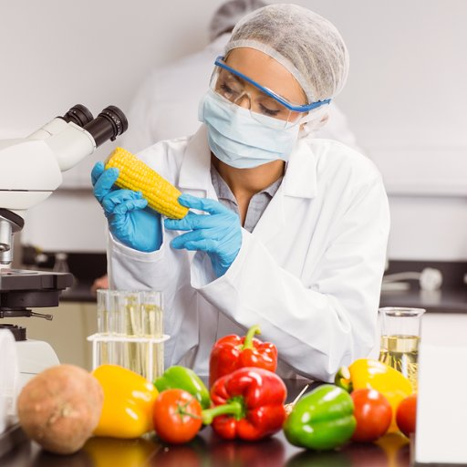
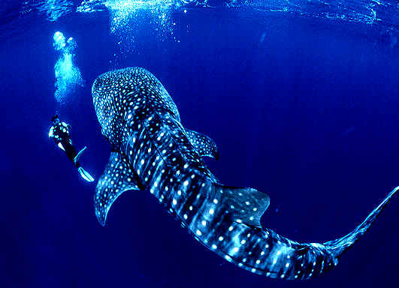
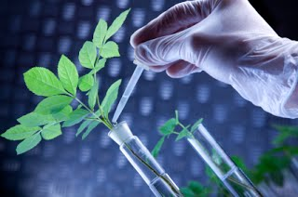
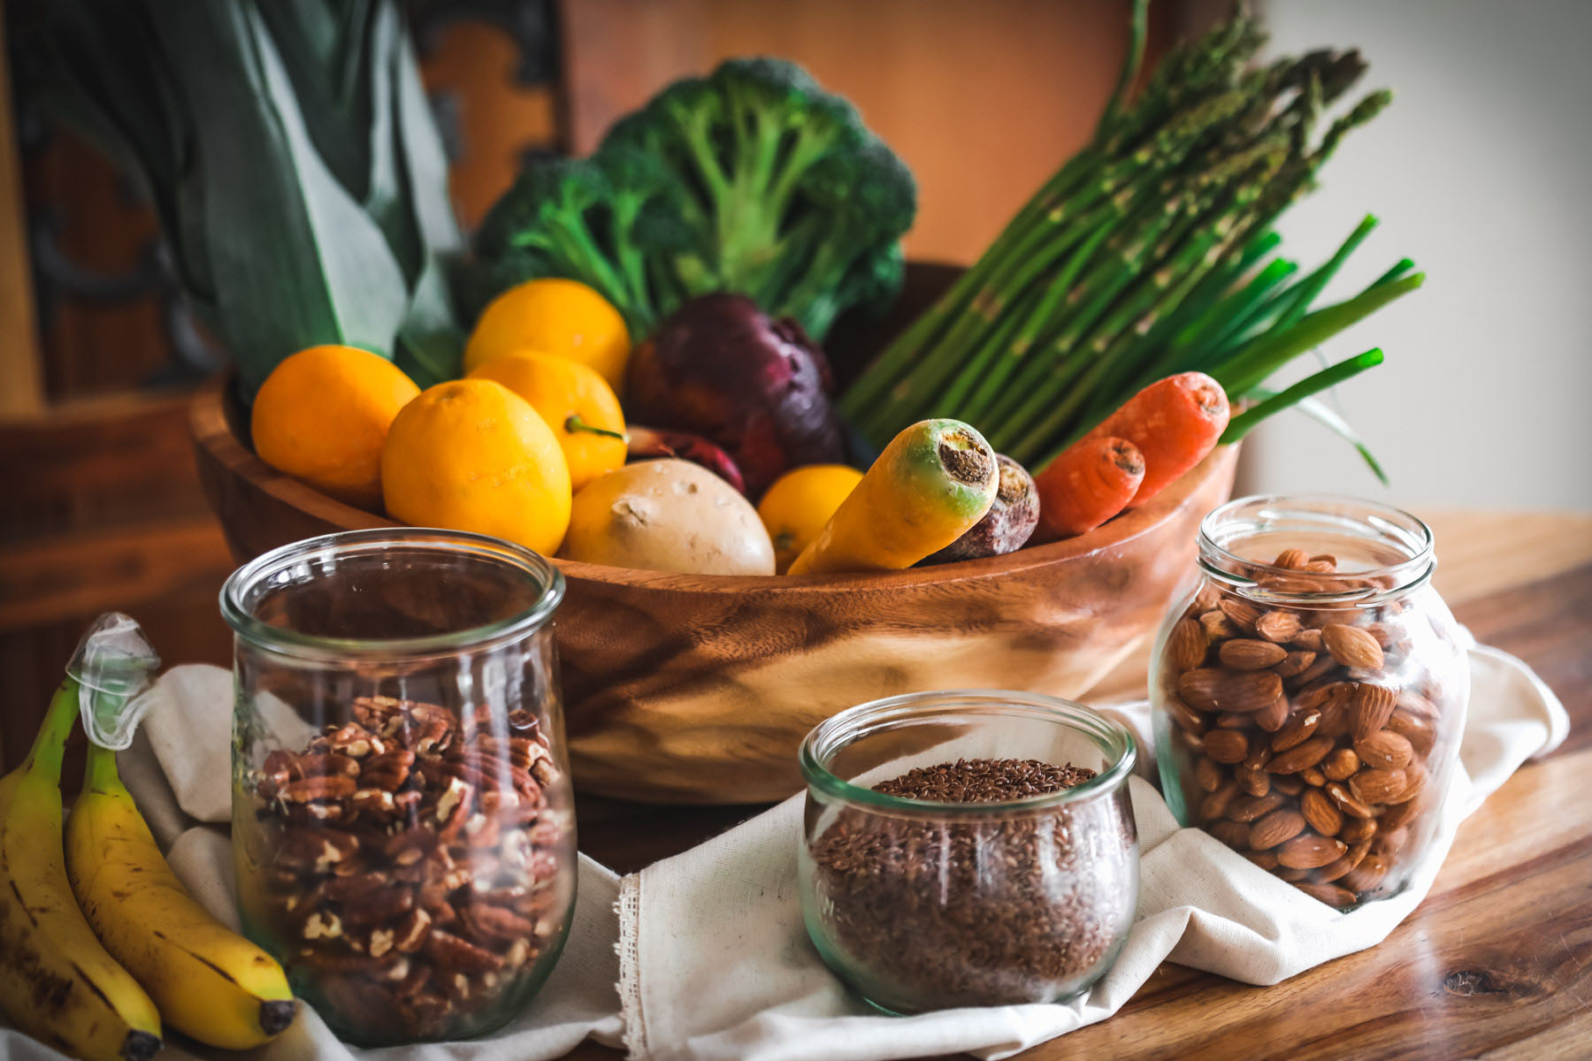
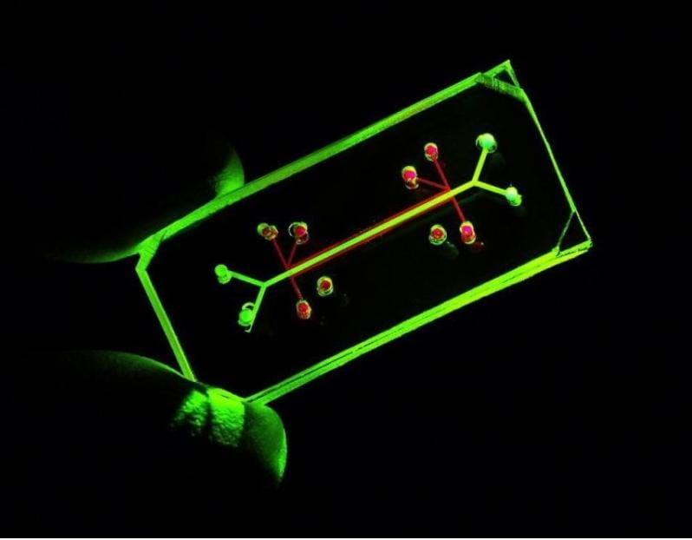
PPLICAATION OF BIOTECHNOLOGY
Name : W.A.L.S.Sankamali Welivita.
Module Code : SC1172
Module Name : Introduction to Information Technology

Slide 2
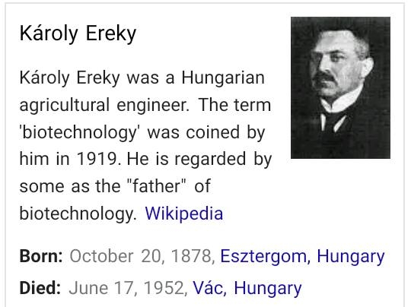
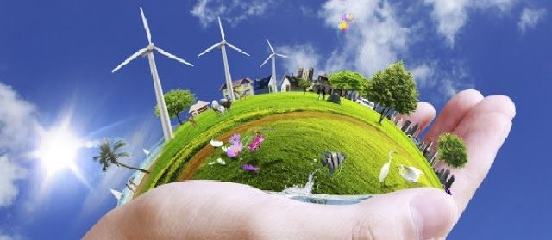
INTRODUCTION TO BIOTECHNOLOGY
Biotechnology is “the application of biological organisms, system or processes to manufacturing and service industries”
Biotechnology is the use of living organisms and their components in agriculture, food and other industrial processes.
Biotechnology is “the application of scientific and engineering principles of the processing of materials by biological agents to provide goods and services”

Slide 3
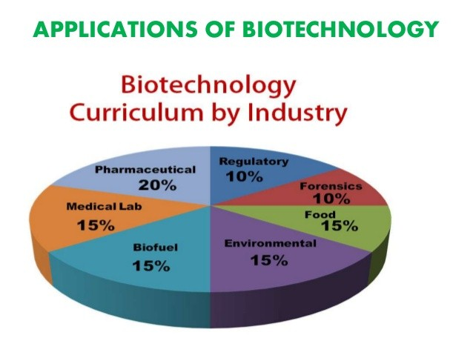
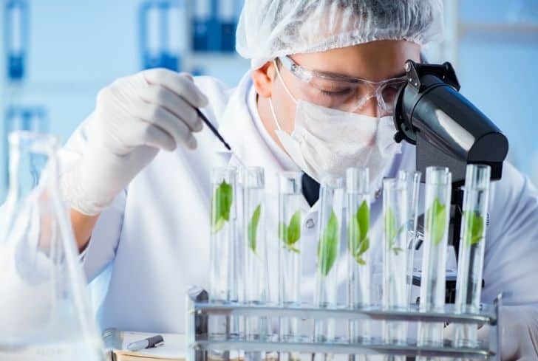
AREAS OF BIOTECHNOLOGY
Food and Agriculture
Medical
Marine and Environmental
Microbial
Molecular
Bioinformatics
Nanotechnology
Industrial

Slide 4
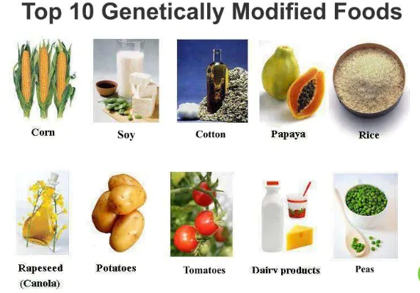
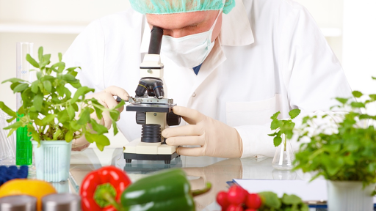
Food and agricultural
Food biotechnology is the evolution of traditional agricultural techniques such as crossbreeding and fermentation.
It is an extension of the type of the type of food development that has provided nectarines, tangerines and similar advancement.
Agricultural biotechnology includes a range of tools that scientists employ to understand and manipulate the genetic make-up of organisms for use in the production or processing of agricultural products.

Slide 5
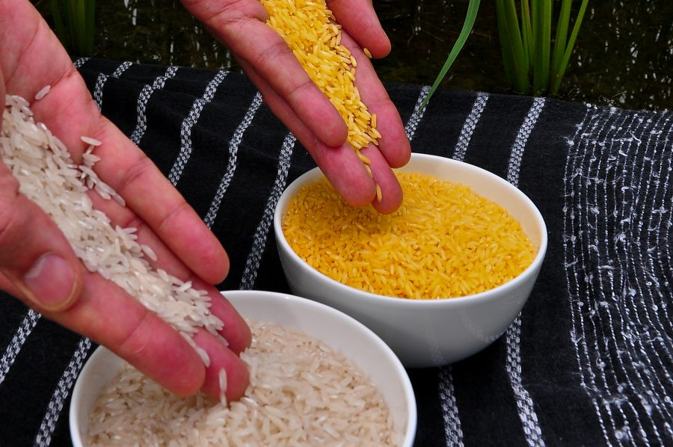
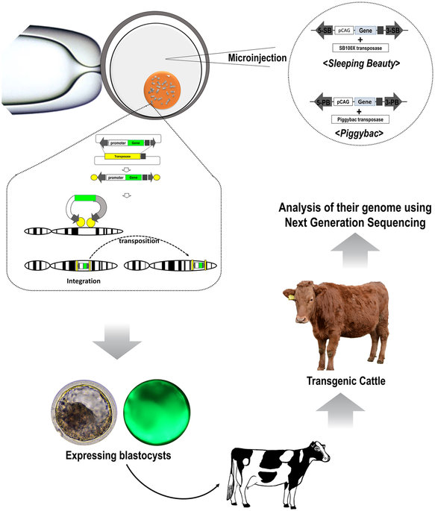
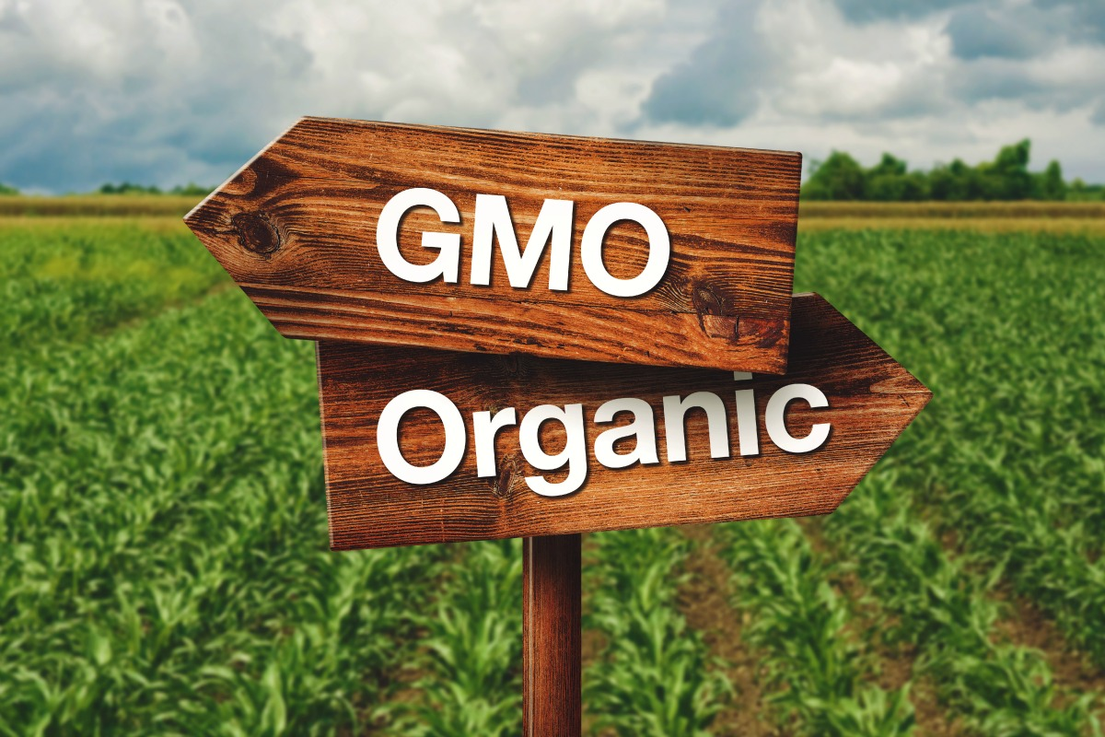
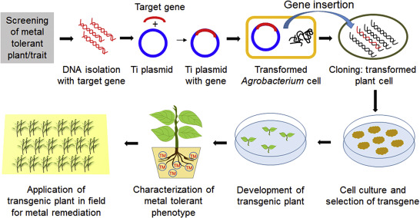
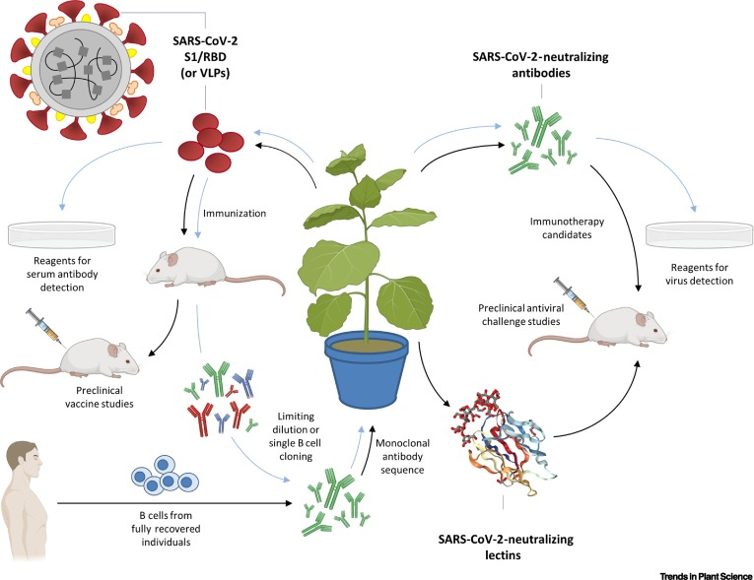
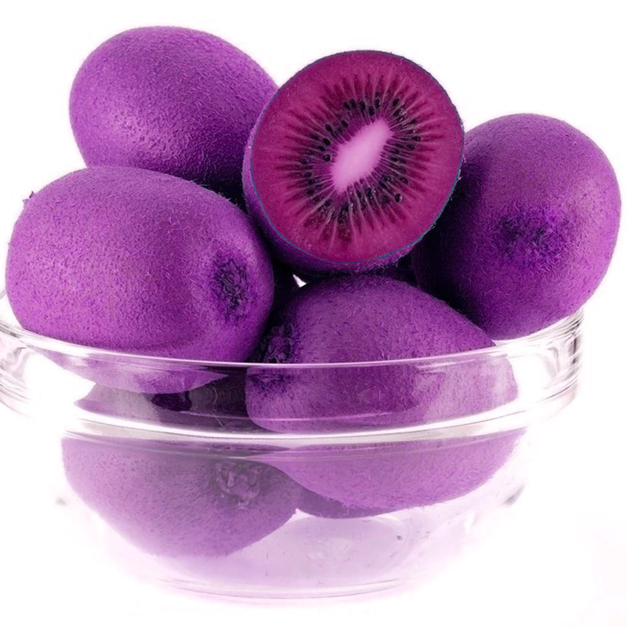
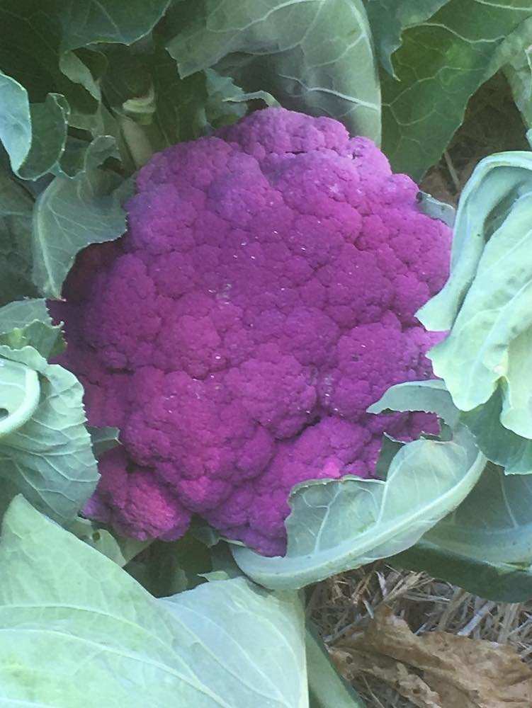
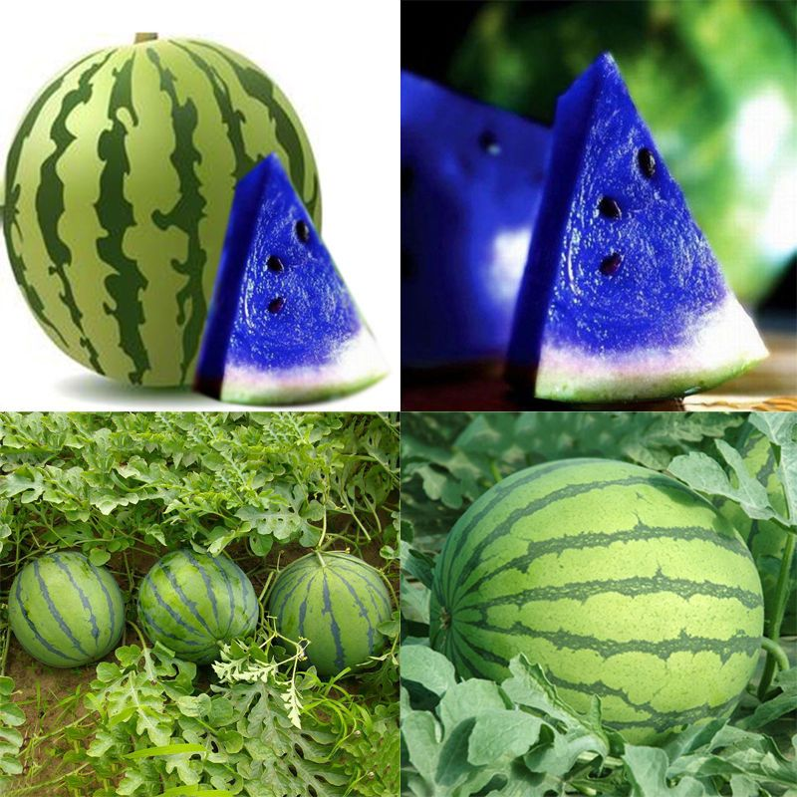
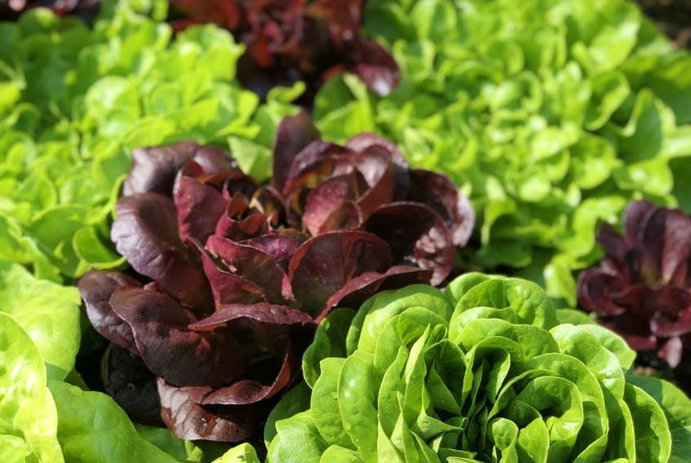
New generation of GM food
E.g.- golden rice.
high carotene mustard seed oil.
vitamin A enhanced cassava.
vitamin A enriched sweet potatoes.
Plant tissue culture
E.g.-potatoes, pineapple, banana.
Plant genetic engineering
E.g.- corn, potatoes
New varieties of plants
E.g.- blue watermelon, lettuce
purple kiwi
purple crush cauliflower

Slide 6
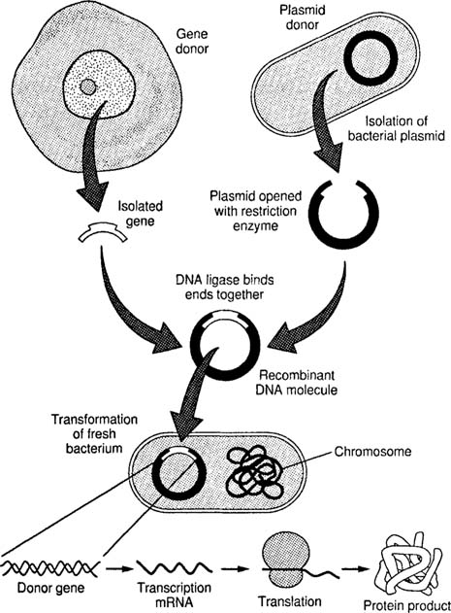
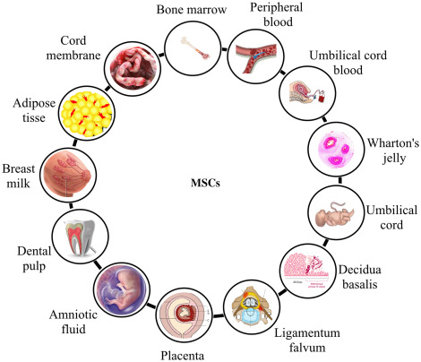
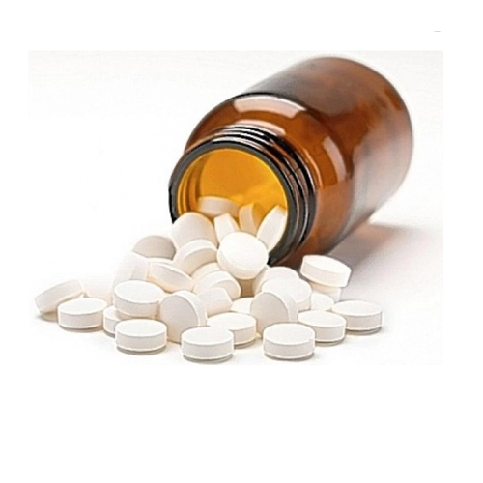
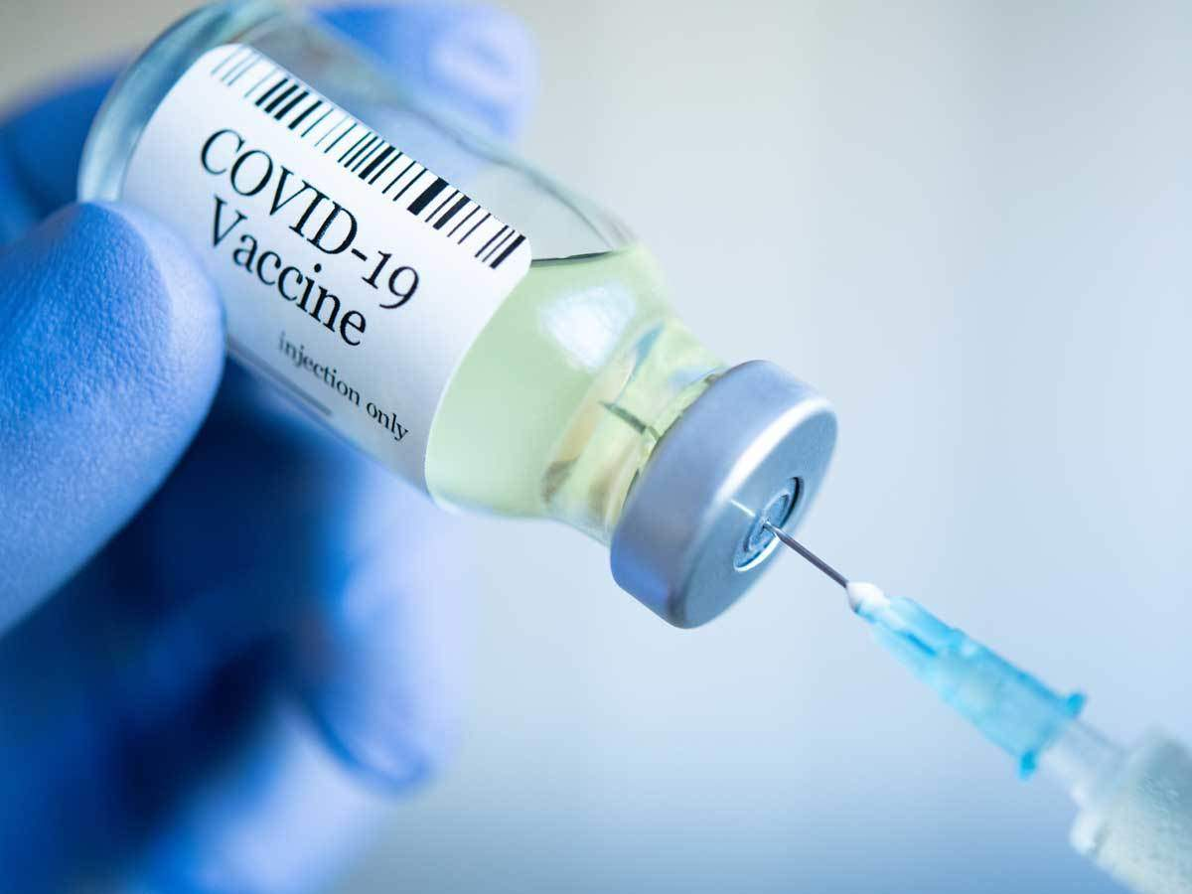
Medical Biotechnology
Medical biotechnology is the use of living cells and cell materials
to research and produce pharmaceutical and diagnostic products
that help treat and prevent diseases.
Biotechnology has played a significant role in modern medicine.
Many medical advancements involve the identification, used and
manipulation of genes.
Genetic testing- using a DNA gene sequence to identify crime
scene DNA , paternity, genetic screening.
Cloning- creating genetically identically identical organism
Tissue culturing-grow human tissues & organs.
Drug development- using biological processes in organisms
to drugs or vaccines.

Slide 7
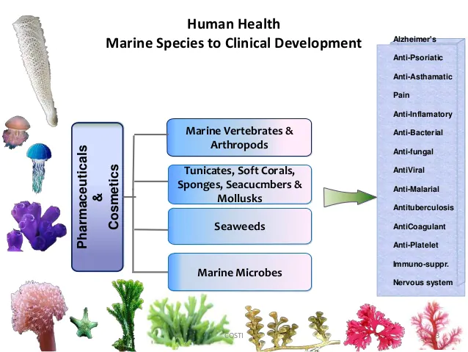
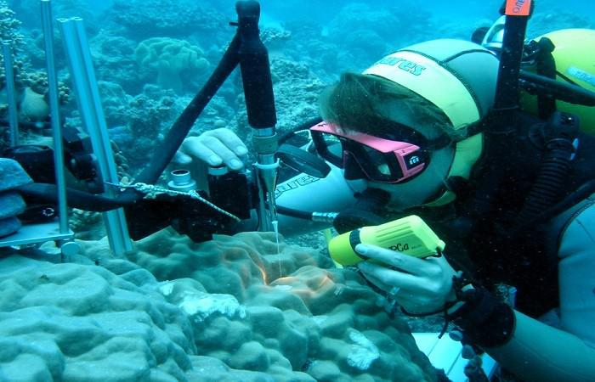
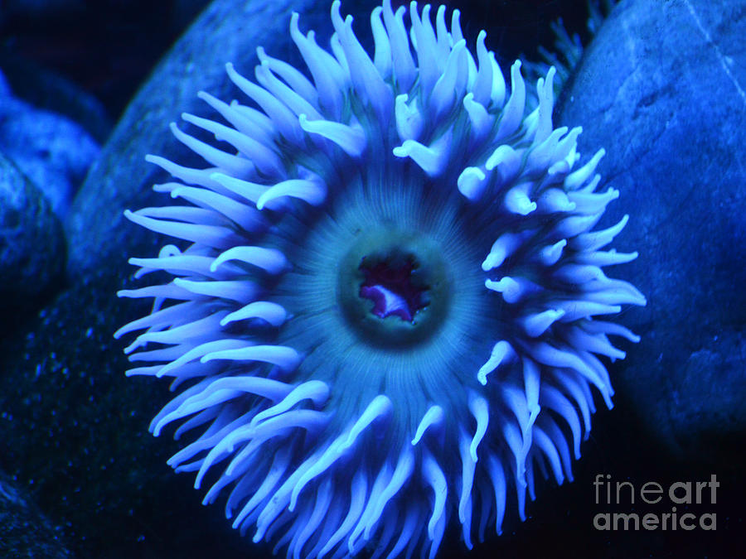
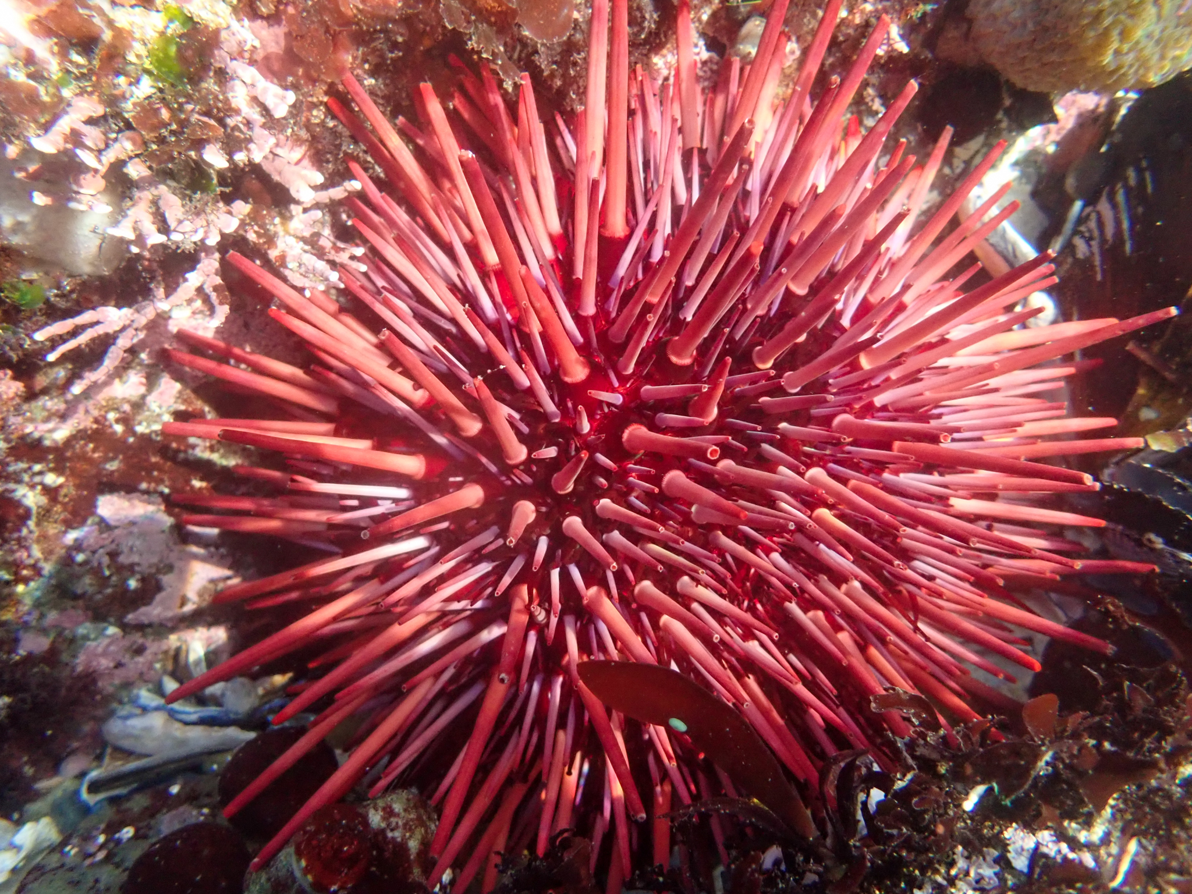
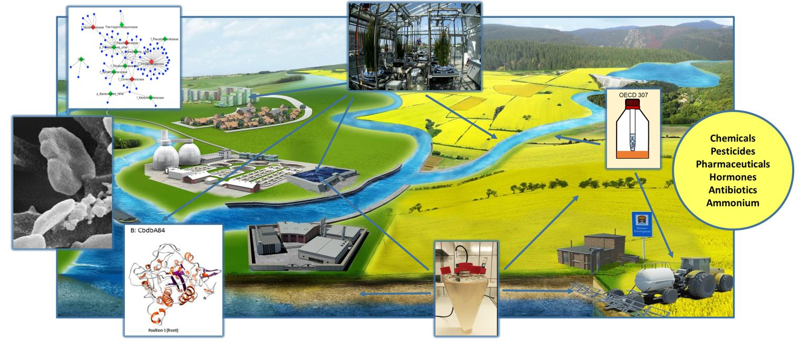
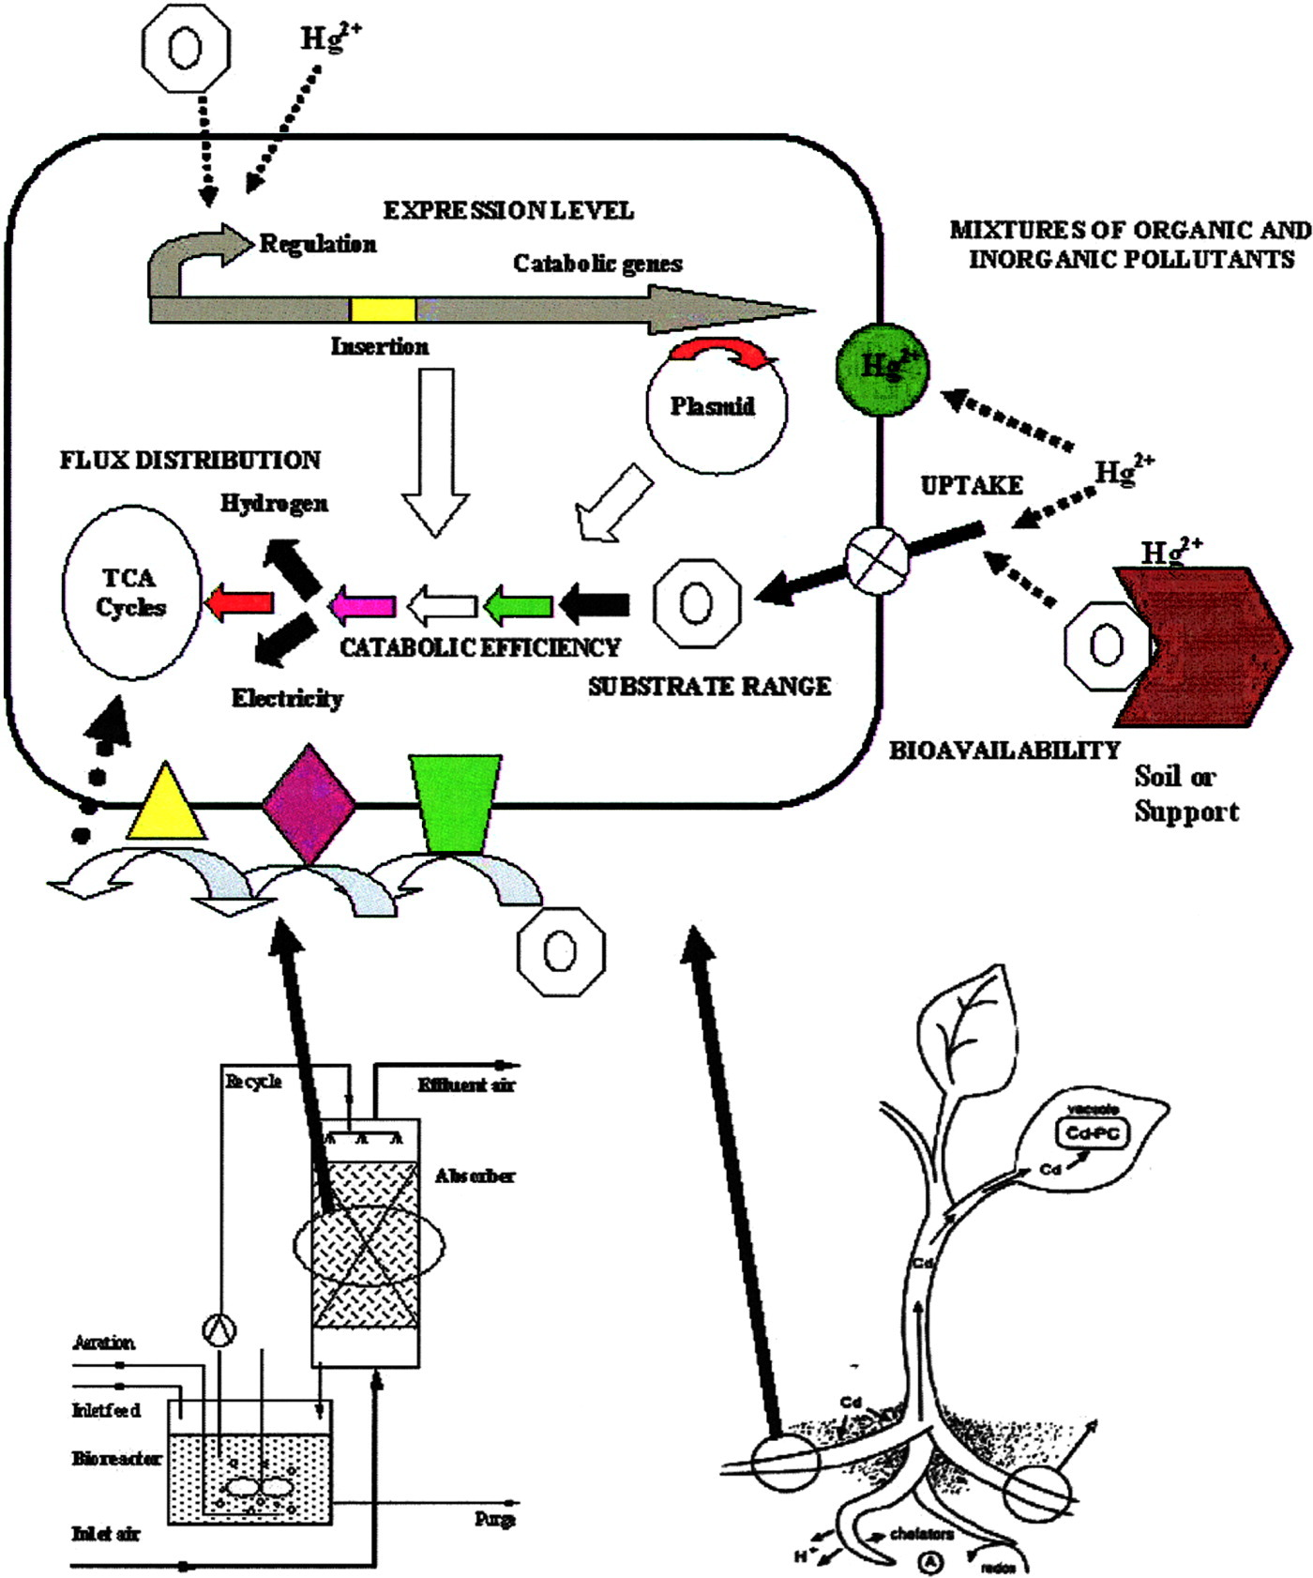
Marine and environmental biotechnology
Marine biotechnology is defined an any technique that use living marine organisms to make or modify products, to improve plants or animal, or to develop microorganisms of specific uses.
Use to :Aquaculture, food, drug design, biofuels, enzymes,
marine living resources.
Environmental biotechnology is the solving of environmental problems through the application of biotechnology.
Use to :biomarker, biosensors,
bioremediation,
Molecular ecology, biofuels.

Slide 8
Reference
https://www.sciencedirect.com/topics/agricultural-and-biological-sciences/agricultural-biotechnology
https://www.fmi.org/blog/view/food-safety-backgrounders/2013/04/01/food-biotechnology-general-scientific-principles-safety-and-regulations
https://www.imedpub.com/scholarly/medical-biotechnology-journals-articles-ppts-list.php
https://www.port.ac.uk/study/courses/msc-medical-biotechnology
https://www.frontiersin.org/articles/10.3389/fmars.2020.00278/full
https://www.earthreminder.com/applications-of-biotechnology-in-environment/
Thank you

